Slide 1
Vision, Goals, Needs, and Values of The Nebraska Early Childhood Strategic Plan
A Dynamic Plan by and for Nebraskans
Notes:
Welcome to this presentation about the Nebraska Early Childhood Strategic Plan. Thank you for taking time to learn more about this work.
The purpose of this presentation is to introduce the background of the Nebraska Early Childhood Strategic Plan and to share the key concepts from the plan with a wider audience.

Slide 2
Purpose
Introduce the Nebraska Early Childhood Strategic Plan
Present Key Concepts
Generate Interest and Involvement
Notes:
For some readers, this will be their first introduction to the Nebraska Early Childhood Strategic Plan. This presentationoutlines the key concepts from the plan and describe our ongoing planning efforts in hopes of encouraging your involvement in the near future.
The number and diversity of stakeholders engaged in the initial development of the Nebraska Early Childhood Strategic Plan in 2019 was limited. It provided an excellent starting place, and now we are expanding our reach and inviting more people into the planning conversation.
A valuable part of the effort to improve the strategic plan will be happening in communities across the state, hosted by community members who work with young children, families, and early childhood professionals every day. We hope that based on what you learn in this presentation, you will decide to become involved in one of these meetings.
At the end of the slides is information about how you can get involved.

Slide 3
Vision All Nebraska children and their families have access to quality early childhood services that support children’s healthy development from birth through age 8.
Notes:
Vision of the strategic plan is that All Nebraska children and their families have access to quality early childhood services that support children’s healthy development from birth through age 8.

Slide 4
A Dynamic Plan by and for ALL Nebraskans
The Nebraska Early Childhood Strategic Plan is grounded in a collaborative and ongoing process of needs assessment, strategic planning, and performance evaluation designed to:
Address the priorities of Nebraskans in diverse and communities across the state
Identify changes at local and state levels that will last over time
Notes:
The Nebraska Early Childhood Strategic Plan is a dynamic plan, written by and for ALL Nebraskans.
What makes it dynamic?
It started in 2019 with a comprehensive, state-wide needs assessment process, during which families and early childhood professionals identified needs, gaps, and barriers they were experiencing in accessing and providing to quality care for all children.
When the findings from the needs assessment were shared with stakeholders across the state, they gave recommendations for action to improve access to quality care.
The goals, objectives, and strategies in the plan are based directly on stakeholders' recommendations.
The needs assessment continues to gather information from families and providers, and we continue to use that information to inform the planning process.

Slide 5
A Dynamic Plan by and for ALL Nebraskans
The strategic planning team is committed to ensuring that the voices of diverse communities are included throughout the strategic planning process and in the 2023 Nebraska Early Childhood Strategic Plan.
Feedback from stakeholders will determine how equity is defined and will be the source of action plans to achieve equity in the strategic plan.
Notes:
We know that the first round of stakeholder engagement did not reach enough people and therefore some voices are not represented in the plan.
In our current efforts, we are prioritizing reaching people in more communities across the state, – including rural areas of the state, people of color, indigenous people, families of children with disabilities, and more – to ensure their perspectives and priorities are included in the 2023 Nebraska Early Childhood Strategic Plan.
In this presentation and in our conversations with stakeholders, we are openly stating the principles of equity that guide our work. We are also offering examples of equity principles that apply to the achievement of each goal of the plan. These statements are intended to be the starting place of this conversation.
As we meet with families and early childhood professionals, we are asking them to describe their needs and priorities for equity in their communities. The feedback we get from stakeholders will define how equity is presented in the 2023 strategic plan and their priorities will be the basis for action plans to achieve equity in early care and education in Nebraska.

Slide 6
Equity Principles for Strategic Planning
ENSURE DIVERSE REPRESENTATION throughout the strategic plan development process.
Design and planning
Stakeholder engagement
Data analysis and writing
Approval
Implement a DATA DRIVEN strategic planning process, WITH DIVERSE POPULATIONS REPRESENTED IN THE DATA.
Ensure the voices of communities that are often marginalized are in in the data
Describe who is and is not accessing services
Intentionally take steps to ELIMINATE IMPLICIT BIAS in the strategic plan development process.
Strategic plan information resources
Stakeholder engagement materials
Set MEASURABLE TARGETS and hold ourselves ACCOUNTABLE.
Define measures for implementing an inclusive and diverse process
Track and report those measures during the life of the project and take corrective action
Notes:
The equity principles for the strategic plan project are as follows.
ENSURE DIVERSE REPRESENTATION because the plan is by and for ALL Nebraskans.
We must include diverse voices in each stage of the work to ensure that those diverse perspectives shape how we engage stakeholders and the language used in the plan.
Implement a DATA DRIVEN strategic planning process, WITH DIVERSE POPULATIONS REPRESENTED IN THE DATA because how the strategic plan is developed will determine its effectiveness in achieving the vision that “ALL Nebraska children have access to quality early care and education.”
Gathering recommendations for action from stakeholders based on data/facts about all Nebraska children is necessary to ensure that the needs and barriers faced by all families and children are addressed in the strategic plan.
ELIMINATE IMPLICIT BIAS in the planning. An implicit bias is an unconscious attitude or stereotype that affects how a person thinks, acts, and makes decisions. By taking steps to identify and remove unconscious bias from the materials used in the strategic planning process, we hope to generate more authentic sharing by stakeholders in every community, leading to a more complete set of recommendations in the strategic plan.
We believe that more stakeholders will feel more ownership of the work if they were engaged without bias, and if they ultimately see the voices of people like them reflected in the plan.
SET MEASURABLE TARGETS AND HOLD OURSELVES ACCOUNTABLE. To be in integrity with our commitment to a diverse process, and to be able to take corrective action during life of the project to help reach our target of including diverse voices, we must track and share indicators about our process with the people we are serving.
Before moving on to describe the key concepts of the Nebraska Early Childhood Strategic Plan, particularly the goals of the plan, the next section provides a description of how stakeholder input has already shaped the way we are conducting the strategic planning process.

Slide 7
How Stakeholder Feedback Has Changed the Process
Stakeholders said …
… and this is what happened.
The Needs Assessment conducted family focus groups across the Omaha metro area with Black and African American, Hispanic and Latinx, immigrant and refugee families, families of children with disabilities, families experiencing poverty or homelessness, and families providing foster care.
… there is not enough focus on diversity of voices or on equity in the Preschool Development Grant work and in the strategic plan.
Surveys of early childhood providers were translated into Spanish.
Notes:
In the first round of needs assessment and planning work, we heard from stakeholders that more emphasis was needed on issues of equity and that we should ensure the voices of more people of color and rural voices are represented in the plan.
In response to that feedback, the Needs Assessment team conducted family focus groups across the Omaha metro area with
Black and African American, Hispanic and Latinx, immigrant and refugee families,
families of children with disabilities,
families experiencing poverty or homelessness, and
families providing foster care.
Also, surveys sent to all licensed providers in the state were translated into Spanish to ensure the voices of more providers were included.

Slide 8
How Stakeholder Feedback Has Changed the Process
Stakeholders said …
… and this is what happened.
… there is not enough focus on diversity of voices or on equity in the Preschool Development Grant work and in the strategic plan.
Current stakeholder engagement is designed to reach previously unrepresented voices;
the process includes recurring accountability checks to ensure that people of color and people in rural areas are reached.
The Race and Equity workgroup was established to ensure that equity is addressed in the strategic plan and other PDG work.
Notes:
In response to the same feedback, the current stakeholder engagement was designed specifically to reach previously unrepresented voices.
The process includes recurring accountability checks to ensure that people of color and people in rural areas are being reached. That is, as meetings are held across the state, we will keep track of who has participated. We will take steps to deliberately reach the groups who have not yet been reached.
The Race and Equity workgroup meets monthly to provide guidance on ensuring that equity is addressed in the strategic plan and other PDG work.
These are just a few examples of how stakeholders' voices have had a direct and valuable impact on the work.
Next, we’ll dive into a summary of the strategic plans’ four goals.

Slide 9
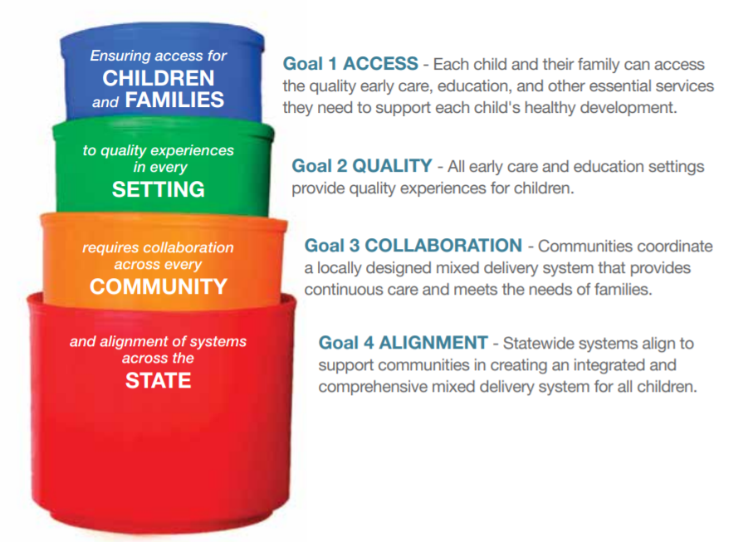
Goals of the Nebraska Early Childhood Strategic Plan
Access Goal – Each child and their family can access the quality early care, education, and other services they need to support each child’s healthy development.
Quality Goal – All early care and education settings provide quality experiences for children.
Collaboration Goal – Communities coordinate a locally designed mixed delivery system that provides continuous care and meets the needs of families.
Alignment Goal – Statewide systems align to support communities in creating an integrated and comprehensive mixed delivery system for all children.
Notes:
The strategic plan lays out four interrelated goals that together will achieve the vision.
The work of the goals, and their integration across the system, is summed up by the statement printed on the stacking cups:
Ensuring access for children and families … to quality experiences in every setting … requires collaboration across every community …. and alignment of systems across the state.
Let’s take a closer look at each of part of this statement.

Slide 10
Ensuring access for children and families...
The Nebraska Early Childhood Strategic Plan:
Places the well-being of children and families at the center of this work
Seeks to ensure that each child in Nebraska can access quality early childhood education and other services that are essential for a child’s healthy development
Notes:
Ensuring access for children and families...means that the Nebraska Early Childhood Strategic Plan focuses on children and their families as the priority of this work, all types of families and all children. The plan calls us to ensure that, no matter where a family lives or what challenges they face, each child in Nebraska can access (i.e., enroll in) quality early childhood education and other services that are essential for a child’s healthy development.
The services that families and children need to access are part of a larger early childhood system.

Slide 11
The Mixed Delivery System: Services Essential for a Child's Healthy Development
Early Care and Education
Center-Based Child Care or Preschool
Home-Based Child Care
School-Based PreK through Grade 3
Parenting
Support
Developmental Screening/
Disability Support
Family
Crisis
Health Care
Social Services
Transportation
Mental
Health Care
Health Care
Housing
Dental Care
Nutrition
Notes:
To support the healthy development and wellbeing of their children, all families must meet basic needs. Depending on the family and the child, to meet these needs they may need to access one or more of the services in the mixed delivery system. The services in this system range from early care and education, to health care, to social services.
The strategic plan seeks to ensure that, when families seek these services, they have access…[next slide]

Slide 12
…to quality experiences in every setting…
SERVICE PROVIDERS
Center-Based Child Care or Preschool
Home-Based Child Care
School-Based PreK through Grade 3
Children and families seek services from professional service providers in various settings, including:
Home-based child care
Center-based early education
School-based early education (PreK through Grade 3)
Health care
Social services
Parenting
Support
Developmental Screening/
Disability Support
Family
Crisis
Health Care
Transportation
Mental
Health Care
Housing
Dental Care
Nutrition
Notes:
…to quality experiences in every setting.
Services in the system are provided by professionals across the different categories.
Early care and education services – at the top of the figure – are provided by home-based care, center-based, and school-based providers.
Health care services are provided by a variety of professionals, including developmental screening and disability support, doctors, occupational therapists, mental health counselors, and dentists.
Social services are provided by social workers and professionals who deliver programs that meet families’ food and nutrition needs, promote stable housing or address family crisis, and other supports for parents and families.
These service providers live and work in diverse communities across the state. Ensuring that these providers have the professional supports they need to provide quality care…[Next slide]

Slide 13
…requires collaboration across every community…
COMMUNITIES
SERVICE PROVIDERS
Center-Based Child Care or Preschool
Home-Based Child Care
School-Based PreK through Grade 3
Everyone has a role in ensuring access to quality early childhood services, including:
Community leaders
School personnel
Business leaders
Nonprofit leaders
Elected officials
Parenting
Support
Developmental Screening/
Disability Support
Family
Crisis
Health Care
Transportation
Mental
Health Care
Housing
Dental Care
Nutrition
Notes:
…requires collaboration at the community level…
Children and families call on service providers who live and work in their community. Many people in the community play an important role in ensuring access to quality early childhood services for the children and families in the community.
Currently, some community leaders, schoolteachers and administrators, and nonprofit organizations are partnering with early childhood service providers.
Over time, we hope to see others become increasingly engaged, including business leaders, more school officials, and elected officials.
Such collaborations depend on people cultivating and maintaining strong, trusting relationships at the local and regional levels. At the same time, these types of collaborations will benefit from coordinating with and learning from state agencies and organizations, and from…[next slide]

Slide 14
…and alignment of systems across the state.
STATE SYSTEMS
COMMUNITIES
SERVICE PROVIDERS
Center-Based Child Care or Preschool
Decisions about statewide policies, funding, and programs involve:
State agencies
Elected officials
Early childhood organizations
Statewide programs, policies, and systems
Institutions of higher education
Home-Based Child Care
School-Based PreK through Grade 3
Parenting
Support
Developmental Screening/
Disability Support
Family
Crisis
Health Care
Transportation
Mental
Health Care
Housing
Dental Care
Nutrition
Notes:
…alignment of systems across the state.
At the state level, agencies and elected officials are involved in decisions related to policies, funding, data management, and evaluation that determine which services are available.
There are also non-profit organizations that oversee and deliver extensive early childhood programs, and partners in higher education providing training for early childhood professionals.
Aligning policies and procedures at the state level will support better coordination of services across all levels of Nebraska’s early childhood system.

Slide 15
Successful implementation of the strategic plan will result in an aligned early childhood mixed delivery system in Nebraska…
STATE SYSTEMS
COMMUNITIES
SERVICE PROVIDERS
Center-Based Child Care or Preschool
Home-Based Child Care
School-Based PreK through Grade 3
Parenting
Support
Developmental Screening/
Disability Support
Family
Crisis
Health Care
Transportation
Mental
Health Care
Housing
Dental Care
Nutrition
Notes:
Putting it all together, this slide illustrates what the state’s early childhood mixed delivery system will look like when the vision is fulfilled:
Families of all kinds …
Accessing quality early childhood services …
With providers who are supported by their communities’ coordination efforts …
Which are also being supported by an aligned state system.
Successful implementation of the strategic plan will result in an aligned early childhood mixed delivery system in Nebraska…

Slide 16
…that provides equitable access to quality early childhood services for each child in Nebraska.
Notes:
…that provides equitable access to quality early childhood services for each child in Nebraska.

Slide 17
But we are not there yet. To achieve the vision and goals, we must work together to address gaps and remove barriers that prevent some children and families from accessing the quality early childhood services they need to thrive.
Notes:
But we are not there yet.
The plan’s vision, goals, and values are informed by a needs assessment, conducted in 2019, that identified the gaps and barriers that prevent some children and families from accessing the quality early childhood services they need to build their wellbeing.
We must continue to work together to build the aligned and collaborative systems the plan calls for so that we can improve equitable access to quality early care and education.
And, importantly, we must remember that the current plan doesn’t yet describe all the strategies and issues we need to consider to get there. There are perspectives and lived experiences not yet represented in the plan we have today.
We need to hear from more voices, from communities we have not yet reached.
The next section of the presentation outlines key concepts associated with each of the four goals.

Slide 18
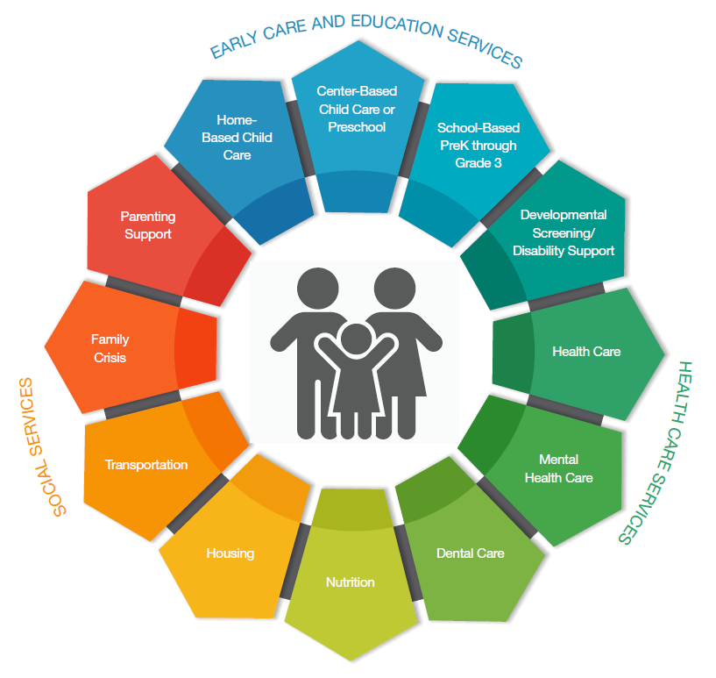
Access means getting through the door.
Notes:
Services may be available in a community, but when we say that families can access services, it means they can enroll their child in a program of their choosing or receive services. That is, they can get through the door.
Each of these tabs on these petals of services is like a door (red circle) – they must be in place and open for families to access the services that will build their well-being.
For some families, some of the doors are closed (gray door), or the service just isn’t available in their community.

Slide 19
Doors close when there are gaps in availability or barriers to access.
Many communities across Nebraska face the following:
Significant lack of available space in early care and education
Limited availability of other essential services
Cost was the barrier most often reported by families to enrolling their child in early care and education. Other barriers include:
Eligibility criteria for child care subsidy that limit access
Transportation to reach care settings
Hours of operation (for families who work shifts other than the typical 8-5)
Only finding options that did not meet families’ expectations for quality
Notes:
Doors close when there are gaps in availability or barriers to access.
Availability refers to having enough early care and education options and other service in each community. Availability is about the supply of quality early care services.
Access refers to a family’s ability to actually enroll their child in the early care setting that best builds the child’s and family’s well-being, without facing undue barriers.
According to the 2019 needs assessment…the primary barriers reported by families were
Cost/ affordability of care
Availability
Flexibility of hours
Transportation
Lack of quality care options that meets their child’s needs

Slide 20
While all children experience a variety of conditions that impact their development and learning...
… families who experience certain types of conditions, or more than one of these conditions, report more difficulty accessing the full range of services they need to build their children’s well-being. These conditions may be:
Unique to the child (such as a disability)
Unique to the parents (such as age, mental illness, or education level)
Affecting the child’s family (such as housing or food insecurity)
Affecting the child’s community (such as discrimination based on perceptions of a child’s or family member's race, ethnicity, or immigration status)
See page 5 of the Strategic Plan Executive Summary for the full list of conditions impacting children’s development.
Notes:
While all children experience a variety of conditions that impact their development and learning
Families who experience certain conditions – or more than one of these conditions – reported more difficulty accessing the full range of services needed to build their children’s wellbeing.
These conditions may be about
the child
the parents
the family as a whole, or
the community they live in.

Slide 21
Creating equity for all families begins with opening the doors that are closed and promoting the well-being of all children.
STATE SYSTEMS
COMMUNITIES
SERVICE PROVIDERS
Center-Based Child Care or Preschool
Home-Based Child Care
School-Based PreK through Grade 3
Parenting
Support
Developmental Screening/
Disability Support
Family
Crisis
Health Care
Transportation
Mental
Health Care
Housing
Dental Care
Nutrition
Notes:
Creating equity means changing elements in the early childhood system that keep the doors to quality services closed. To some but not others.
Creating Equity for all families starts with opening the doors that are closed, so that every family can access to the full range of services that will promote the healthy development of each child.
Here, we’re talking about changing structural barriers to opportunity, access, and quality of service. The burden for change is on the system, not the families.
For example, for a family with a child with special needs, a lack of transportation, caregivers not trained to understand specialized needs, and high cost of specialized care are all factors that limit access. These factors create inequitable access to quality care for this family’s child.

Slide 22
Creating equity for all families begins with opening the doors that are closed and promoting the well-being of all children.
STATE SYSTEMS
COMMUNITIES
SERVICE PROVIDERS
Center-Based Child Care or Preschool
Home-Based Child Care
School-Based PreK through Grade 3
Parenting
Support
Developmental Screening/
Disability Support
Example Equity Principle
Examine data about barriers and which children are getting served, and which are not.
Based on the usage patterns, change policies that limit access and increase financing to make quality early learning services available to all children.
Family
Crisis
Health Care
Transportation
Mental
Health Care
Housing
Dental Care
Nutrition
Notes:
An Example Equity Principle for this goal is: Examine data about which children are getting served, and which are not. And, based on the service usage patterns, change policies that limit access and increase financing to make quality early learning services available to all children.
Acting on this principle, the agency that defines workforce training standards might use data about children with different conditions to understand what skills the early childhood workforce should have to be able to meet all children’s needs.
They would then add requirements for caregivers to be trained to meet these specialized needs.
Acting on this principle, state policy makers would examine patterns of child care usage and costs faced by different families.
They would then make policy changes that allow different funding sources to be used to cover different needs in a single setting.
Together these changes would mean a family with a child with special needs would have the additional cost of specialized care covered and the child could experience a stable environment that can meet all of her needs.
These actions reflect changes in the system that are focused on promoting the wellbeing of each child.

Slide 23
Stakeholder Feedback that Got Results
Stakeholders said …
… and this is what happened.
The Nebraska Child Care Referral Network (CCRN) was developed to help working parents find child care in their area for children from birth to age 12. NEChildCareReferral.org
The website allows parents to search for providers using filters including:
Type of child care environment
Type of child care license
Ages of children needing care
Geographical distance
Does/does not accept subsidy
Step Up to Quality participation
…they would like to have a list of child care providers in their area with information about cost, quality ratings, availability, and user reviews.
Notes:
Before moving on to the Quality Goal, here is an example of when early childhood collaborators’ feedback led to a new resource being available that affects Access.
The 2019 Needs assessment, families said they needed reliable and real-time information about where child care spaces were available; and they would like to have a list of child care providers with information about cost, quality ratings, availability, and user reviews.
In 2020, when the pandemic forced so many doors to close, many parents still needed to find child care for their children. The Nebraska Child Care Referral Network (CCRN) was developed to help working parents find child care in their area for children from birth to age 12. The website allows parents to search for providers using filters. NEChildCareReferral.org
All licensed providers are invited to post their information on the website and the information on the website is updated frequently.
Also, in the survey of providers in April 2020 that led to the CCRN being built, providers said they couldn’t find thermometers and essential cleaning supplies. The partners who conducted the survey, took the information and figured out how to deliver thermometers and other cleaning supplies to the providers who needed them.

Slide 24
Quality early care and education is defined in terms of what each child experiences.
A quality experience is characterized by positive and language-rich interactions between the developing child and familiar, caring adults–no matter the setting.
Sensitive and responsive interactions
Notes:
The Nebraska Early Childhood Strategic Plan defines quality early care and education in terms of the child’s experience.
Quality early care and education is defined by what each child experiences and is characterized by positive and language-rich interactions between the developing child and familiar, caring adults – no matter the setting.
Often, people talk about quality in terms of the environmental characteristics that would enable a child to thrive --- such as the design and cleanliness of the facilities, the teaching materials, and teacher qualifications. And, indeed, those things are very important, because they contribute to the conditions where children can experience sensitive and responsive interactions with caring adults.
However, without the connection of the warm, caring adult attending to individual needs where the child feels safe and known, a child may not receive the benefits of the lessons, the developmentally appropriate space and toys, or the training that staff received.

Slide 25
Structuring Settings to Promote Quality
To increase the likelihood that a child experiences quality, early care and education, settings are structured to:
Promote the well‑being of early childhood professionals (appropriate qualifications and training, promotion of physical and mental health, appropriate compensation and professional supports)
Foster the child’s healthy development and learning (developmentally appropriate materials, routines, ratios, and individualized instruction; culturally relevant family engagement; clean and safe facilities)
Notes:
Creating the space where a child experiences quality depends on the training and well being of the professionals caring for the child.
Ensuring these professionals have the qualifications and training to provide the caring and language-rich experiences
Ensuring these professionals are physically and mentally well
Creating the space where a child experiences quality depends on a focus on fostering the individual child’s development.
Ensuring learning materials are appropriate to each child’s age and ability and materials for the child and engagement with the families are culturally relevant.

Slide 26
Shaping Policies and Practices to Promote Quality
The delivery of quality care and education across settings is facilitated by policies and continuous quality improvement practices that prioritize the child’s experiences, including, for example:
Policies designed to enable providers to cover the full cost of quality care
Assessment practices that capture the child’s experiences of quality
Notes:
Creating the space where a child has a quality experience (that language-rich and caring 1:1 relationship) depends on
policies and practices that establish this definition of quality in the regulations
making it financially possible for providers in all settings to provide quality experiences, and
developing methods to assess (or measure) the quality experience and not evaluating providers on something else.

Slide 27
Creating equitable access to quality means every child experiences language-rich, caring one-on-one interactions in all settings.
Notes:
By defining quality in terms of the child’s experience, the strategic plan seeks to promote equitable access to quality in all settings for all children.
This means changing the systems that surround early care providers so that every door a family walks through provides quality care – individualized, caring, language-rich, and welcoming care for students from every background.
This means that once they are enrolled in a program, each child experiences caring interactions that meet their individual needs and abilities.

Slide 28
Creating equitable access to quality means every child experiences language-rich, caring one-on-one interactions in all settings.
Example Equity Principle
Create practices and policies that cultivate early care environments that minimize the impact of adults’ implicit bias on young children’s development and learning.
Notes:
An Example Equity Principle for this goal is: Create practices and policies that cultivate early care environments that minimize the impact of adults’ implicit bias on young children’s development and learning. Remember that an implicit bias is an unconscious attitude or stereotype that affects how a person thinks, acts, and makes decisions.
Unless they examine their own biases, teachers may treat children with certain characteristics differently without knowing why.
Providers acting on this principle would recruit, hire, and retain early childhood professionals
who reflect the diversity of and speak the languages of children and families being served; and
who meet professional standards.
Agencies acting on this principle would establish professional standards for early childhood educators
that include training to assess whether the learning environment fits the developmental, cultural, and language needs of each child in their care; and
that include training to examine their own implicit biases and how those biases contribute to their interactions with each child.

Slide 29
Stakeholder Feedback that Got Results
Stakeholders said …
… and this is what happened.
… that earning a degree in early childhood development does not necessarily lead to a subsequent increase in wages. To earn more, early childhood professionals must be certified to work in school settings.
The University of Nebraska is working with state colleges, tribal colleges, and community colleges across the state to bring more equity to the early childhood programs in all institutions across the state.
Work has already begun to create
a career lattice,
stackable credentials, and
apprenticeships that can make the EC profession a priority profession.
Notes:
Before going on to the Collaboration goal, here is another time when input from early childhood collaborators led to needed changes.
The Early Childhood Workforce Commission surveyed Nebraska’s early childhood professional workforce. The early childhood professionals reported that unless they get certified to work in a school setting, having a degree in early childhood education does not necessarily mean they will earn more than someone without the degree.
As a result of this information, The University of Nebraska is working with state colleges, tribal colleges, and community colleges across the state to bring more equity to the early childhood programs in all institutions across the state. Work has already begun to create
a Career Lattice,
stackable credentials, and
apprenticeships that can make the EC profession a priority profession.

Slide 30
Collaboration refers to community-level coordination of local and regional resources to promote the well-being of all children and families.
STATE SYSTEMS
COMMUNITIES
SERVICE PROVIDERS
Center-Based Child Care or Preschool
Home-Based Child Care
School-Based PreK through Grade 3
Parenting
Support
Developmental Screening/
Disability Support
Family
Crisis
Health Care
Transportation
Mental
Health Care
Housing
Dental Care
Nutrition
Notes:
Early care providers, and the organizations that support them through training and coaching, are all working very hard to increase quality in early childhood services. These providers and organizations all live and work within communities, and each community has unique resources and needs.
Collaboration is needed at local and regional levels to promote quality early childhood services for all children and families. The more collaboration and coordination there is at the local and regional levels --- among providers, school personnel, early learning coaches, business and non-profit leaders, local officials, families, and others --- the more likely it is that providers will have access to the tools and resources required to build children’s wellbeing by providing quality experiences.
In 2019, stakeholders repeatedly described limits in collaboration, including:
Limited communication between early care providers and school personnel. This included
Limited communication about children’s developmental potential, particularly as related to children making the transition to Kindergarten; and
Limited sharing of professional development resources.
Stakeholders described inconsistent capacity to coordinate services in different communities.
We heard about some communities that had effective plans in place to coordinate resources; in some cases, several communities across counties pooling resources to promote the well-being of families and children.
We also heard about communities that had no coordination plans or efforts in place.
This limited collaboration and inconsistent coordination contributes to gaps in continuity of care.

Slide 31
Collaboration and consistent coordination of resources ensure more continuity of care.
STATE SYSTEMS
COMMUNITIES
SERVICE PROVIDERS
Center-Based Child Care or Preschool
Home-Based Child Care
School-Based PreK through Grade 3
When a child experiences continuous care, their participation in care settings is stable, with few daily or weekly changes.
Parenting
Support
Developmental Screening/
Disability Support
Family
Crisis
Health Care
Transportation
Mental
Health Care
Families with children who have disabilities and other special needs face unique challenges to experiencing continuous care.
Housing
Dental Care
Nutrition
Notes:
Collaboration is essential for ensuring continuity of care, which is a critical part of ensuring that a child experiences quality.
A child experiences continuity of care when their care settings are few in number and offer stability. This means that a child is not moved between settings
in a single day, week, or month because of their family’s work schedule, or because of limited availability in the community.
The stability created by continuous care prevents them from breaking and reforming the relationships that are at the center of a quality experience. Each of those changes creates a stressor for the family and the child; experiencing that stressor repeatedly will negatively affect their development and learning.
In the needs assessment, families that reported several of the challenging conditions listed earlier (slide 20) were nearly twice as likely as other families to have changed their care arrangement two or more times in the last year.

Slide 32
Collaboration strategies that increase access to quality care
STATE SYSTEMS
COMMUNITIES
SERVICE PROVIDERS
Build new and collaborative relationships in the community
Increase communication around transition to Kindergarten
Ensure representation across the community
Develop local or regional plans to improve access to quality care
Coordinate with state-level partners to support plans to build families’ well-being
Center-Based Child Care or Preschool
Home-Based Child Care
School-Based PreK through Grade 3
Parenting
Support
Developmental Screening/
Disability Support
Family
Crisis
Health Care
Transportation
Mental
Health Care
Housing
Dental Care
Nutrition
Notes:
Early childhood collaborators recommended several strategies that will support community-based collaboration and increase access to quality early care and education. These include
Building relationships between early care providers and school personnel in the community.
Increasing communication between early care providers and schools, especially around the transition to kindergarten.
Bringing new partners to the table to ensure full representation in collaborative planning efforts.
Facilitating ongoing collaboration among community leaders as they identify community strengths, resources, and priorities, with a focus on developing local or regional plans to improve access to quality care.
Collaboration also includes state-level partners working together to help communities plan and implement changes that will build children’s and families’ well-being.

Slide 33
Creating equity through collaboration means including diverse representation from across the community in developing plans that ensure community resources benefit all children.
Notes:
Creating equity in collaboration means including diverse representation from across the community to develop a coordinated network of early childhood services – and creating plans that ensure community resources benefit all children.
As stated earlier, families and children are the focus of the work of the strategic plan, but the focus for change is the service delivery system to redesign it so to focus on helping build the children’s and families’ wellbeing.
Community collaborators and leaders have the best understanding of the people, resources, and other factors that impact local families. Their role is central to planning connections and opportunities to link all families to early childhood providers and other resources and to identify needed services and resources that will meet all families’ needs.

Slide 34
Creating equity through collaboration means including diverse representation from across the community in developing plans that ensure community resources benefit all children.
Example Equity Principle
Ensure diverse representation in creating coordinated, community-based plans and in making decisions about using local resources.
Notes:
An Example Equity Principle for this goal is: Ensure diverse representation in creating coordinated, community-based plans and in making decisions about using local resources.
Community leaders and organizers acting on this principle know that giving voice to diverse perspectives will strengthen the network of resources available to all children and families.
Therefore, they might create a space to develop collaborative relationships between early care providers, school personnel, and social service agencies within the community.
From the beginning of community-based planning, they might take steps to ensure representatives from all cultural groups and families with specific needs are represented.

Slide 35
Stakeholder Feedback that Got Results
Stakeholders said …
… and this is what happened.
… that early child care providers and schoolteachers wanted to better prepare children and classrooms for the transition to kindergarten.
With Preschool Development Grant funds, the Nebraska Transition to Kindergarten Toolkit and Resource Guide was made available to early childhood providers, professionals, and schools statewide.
https://www.education.ne.gov/oec/nebraska-transition-to-kindergarten-toolkit-and-resource-guide/
Notes:
Before moving on to the alignment goal, here is another example of partners in early childhood organizations coming together to create a resource to meet a need expressed by stakeholders.
In meetings across the state, early childhood educators, schoolteachers, and other community-based partners expressed a desire to be better able to prepare classrooms and work across settings to help young children successfully make the transition to kindergarten.
With preschool development grant funds, a workgroup of experts was convened to identify research-based activities, strategies, and resources specific to families, schools, and early care and education providers that support transition into kindergarten. As a result, the Nebraska Transition to Kindergarten Toolkit and Resource Guide was created and is available to early childhood providers and schools statewide. This toolkit presents a common understanding of developmentally appropriate expectations and practices that support continuity in transitions for young children.

Slide 36
Alignment focuses on a shared vision for Nebraska’s early childhood system that will shape funding and policy decisions to ensure equitable access to quality early care and education.
STATE SYSTEMS
COMMUNITIES
SERVICE PROVIDERS
Center-Based Child Care or Preschool
Home-Based Child Care
School-Based PreK through Grade 3
Parenting
Support
Developmental Screening/
Disability Support
Family
Crisis
Health Care
Transportation
Mental
Health Care
Housing
Dental Care
Nutrition
Notes:
The fourth goal of the strategic plan focuses on making changes to the early childhood system at the state level, identifying strategies that will empower communities, providers, and families to collaborate in building the well being of children through access to quality care. The alignment goal focuses on the processes of the state agencies and state-level organizations that make resources available to families and providers.
Stakeholders identified these strategies as necessary to achieve the goal of alignment:
Create a shared vision - among the public, policy makers, and community leaders - about the importance of quality early childhood care and education
Align policies to the shared vision that facilitate investment and prioritization of resources to ensure each child has access to quality early care and education
Simplify the administrative processes that make resources available more easily and consistently
Facilitate standardized and integrated data about available services and about the families and children using early childhood services
Establish rigorous and continuous efforts to track the progress toward the desired changes outlined in the strategic plan
Create a leadership framework that uses the strategic plan to guide early childhood systems change over time.

Slide 37
A lack of alignment in early childhood systems creates barriers for families and professionals at all levels, limiting access to quality early education and other essential services.
STATE SYSTEMS
COMMUNITIES
SERVICE PROVIDERS
Center-Based Child Care or Preschool
Home-Based Child Care
School-Based PreK through Grade 3
Parenting
Support
Developmental Screening/
Disability Support
Family
Crisis
Health Care
Transportation
Mental
Health Care
Housing
Dental Care
Nutrition
Notes:
During the pandemic, people across the country became acutely aware of how important early care and education is, not only for the healthy development of our children and families, but to the functioning of our communities and our economy.
In 2019, early childhood collaborators across the state voiced a similar theme—emphasizing that everyone needs to understand the value and impact of quality early care and education on children, the community, the economy, and the nation. Stakeholders named several barriers to alignment.
While many partners work toward improving outcomes for young children, we learned from key informant interviews that sometimes organizations working in the field do not understand how their own work complements or conflicts with the work of others.
Key informants talked about the systemic barriers that stem from state-level policies and procedures, including funding and administrative policies that restrict access to services. These barriers put pressure on the providers to work through the different systems to get the funding needed to run their business, rather than focus on caring for children.
Finally, there are limitations in the available early childhood data, including lack of shared measurement and accountability tools. Currently, community leaders and policy makers do not have access to the full range of data needed to make informed decisions about policies, funding, and programs.
These barriers to alignment in state-level early childhood systems creates barriers for families and professionals at all levels, limiting families’ and children’s access to quality early education and other essential services.

Slide 38
Creating equity through alignment means intentionally changing statewide systems to ensure each child in Nebraska has access to quality early childhood education and other essential services.
Notes:
Creating equity through alignment means intentionally arranging statewide systems (through messages, policies, funding, and programs) to ensure that each child in Nebraska has access to quality early childhood education and other essential services.

Slide 39
Creating equity through alignment means intentionally changing statewide systems to ensure each child in Nebraska has access to quality early childhood education and other essential services.
Example Equity Principle
Set measurable targets and track progress of change.
Adapt strategies for systems change as the impact of the work shifts the landscape.
Notes:
An Example Equity Principle for this goal is: Set measurable targets and track progress; then adapt strategies as the impact of the work shifts the landscape
State agency leaders and policy makers acting on this principle would select or create indicators of progress that demonstrate how policy and funding changes are
increasing access to quality care for children and families from groups who were historically marginalized
establishing equitable wages and benefits for caregivers with the same qualifications across home-, center-, or school-based settings
Working together in a shared-leadership approach to changing the early childhood system, they would collaborate with private partners and track and report those measures regularly to evaluate effectiveness and then revise strategies as needed to make more progress.

Slide 40
Stakeholder Feedback that Got Results
Stakeholders said …
… and this is what happened.
… all Nebraskans need to understand the value and impact of quality ECCE on children, the community, the economy, and the nation.
The Nebraska Early Childhood Campaign is being launched in June 2022. Its overarching goal is to build support for quality ECCE. Its objectives include
Promoting an aligned understanding of quality early childhood education
Increasing appreciation of the role of the early childhood workforce
Expanding recognition of the economic importance of quality early education and the early childhood workforce
Notes:
Here is another example of how feedback from stakeholders led to a change in the early childhood system.
Across the state in 2019, stakeholders said that all Nebraskans need to understand the value and impact of quality early care and education on children, the community, the economy, and the nation, because everyone (parents, families, early childhood providers, schools, businesses, community leaders, state agencies, and nonprofit organizations) – whether they know it or not – has a vested interest in supporting the healthy development and learning of each child.
The Nebraska Early Childhood Campaign – a public outreach and education campaign – was launched in June 2022. Its overarching goal is to build support for quality early childhood care and education. The target audiences include are parents and families, the early childhood workforce, and community and opinion leaders.
Its objectives include:
Promoting an aligned understanding of quality in early childhood care and education across audiences
Increasing the understanding and appreciation of the role of the early childhood workforce in providing quality early childhood care and education in Nebraska
Expanding recognition of the economic importance of quality early care and education and the early childhood workforce in Nebraska with influencer and workforce audiences
Building public will for access to quality early childhood care and education across all three target audiences
Increasing communications capacity among campaign partners and collaborators to sustain and continue community engagement efforts made in public campaigns
Now that we’ve covered the four goals of the strategic plan, we will move into a description of the values that stakeholders identified that should guide the development of the plan and the implementation of the strategies under the goals.

Slide 41
Values that Guide the Strategic Plan Expressions of intention that define how and why the goals, objectives, and strategies will be implemented.
Notes:
Stakeholders who informed the goals and objectives of the strategic plan also communicated values that should guide the work of the strategic plan.
By defining shared values, we describe how we want the future early childhood system to work and how we will go about achieving it.
These values are expressions of intention that define how and why the goals, objectives, and strategies will be implemented.

Slide 42
Nebraska Early Childhood Strategic
Plan
Values
Equity
Notes:
The first value is Equitable Access for all children and families, or Equity.
Equity involves promoting the well-being of all children by addressing disparities in opportunities, family supports, and child outcomes.
To realize the value of equity in the implementation of the strategic plan, this value must be intentionally cultivated in the development of collaborative relationships and in our efforts to align the systems that serve families. This means learning more from people of color and people in rural areas, listening to those voices, and being led by those voices. It means ensuring that the voices of the people impacted by the work are involved in:
developing the plan,
designing strategies to implement it, and
developing the methods of evaluating success.

Slide 43
Equity
Nebraska Early Childhood Strategic
Plan
Values
Whole
Child
Approach
Notes:
The second value is a Whole Child Approach.
When we talked about Quality earlier, we understood that providing quality experiences requires caring for the whole child – their unique and individual physical, emotional, social, and educational needs. Providing quality care also requires recognizing that the child lives within a family and within a community, all with unique strengths, resources, and challenges.
The goals of the strategic plan will be more successful if this philosophy of the whole child nested in their family and community is embedded as an assumption of the strategies and action plans.

Slide 44
Equity
Whole Child
Nebraska Early Childhood Strategic
Plan
Values
Shared
Responsibility
Notes:
The third value is Shared Responsibility for creating an effective early childhood system. The range of people and organizations who can play a role in improving the early childhood system is very broad.
The toddlers of today are the educators, the police, the doctors, the plumbers, and the leaders of tomorrow.
They are the wives, husbands, partners, and parents of the future.
By creating systems and programs that help build the wellbeing of young children and families, Nebraska gives its youngest citizens a great start to reach their potential and make great contributions to their own families and communities.
This means we need more people involved, more collaborators at the table involved in planning; more partners, new and untraditional partners included in the discussions of policy, funding, and strategy to reach the goals; because these decisions will affect everyone.

Slide 45
Equity
Whole Child
Nebraska Early Childhood Strategic
Plan
Values
Community
Leadership & Collaboration
Shared Responsibility
Notes:
The next value is Community Leadership and Collaboration.
Simply put, community leaders know what will work in their communities better than anyone from outside. They know local resources and businesses and families. They have relationships built on years of collaboration.
The strategic plan calls for state programs to offer resources to support communities but developing local plans must be driven by those who live in and know the community. And, developing local plans that will truly create equitable access means bringing new leaders to the planning table, new voices to ensure that the entire community is represented.

Slide 46
Equity
Whole Child
Nebraska Early Childhood Strategic
Plan
Values
Shared Responsibility
Continuity
of Care
Community Leadership
Notes:
The next value, Continuity of Care, is not only a value to incorporate into the work of each goal, but also an outcome of implementing the strategic plan.
As partners work together to create an aligned early childhood system, they must intentionally design changes that support more continuity of care for young children. Only by intentionally designing it into the system will we create:
consistency in early education which enables children to experience more quality and
coordinated access to the other essential services they that will promote healthy development and learning.

Slide 47
Equity
Whole Child
Nebraska Early Childhood Strategic
Plan
Values
Shared Responsibility
Wise
Stewardship
Community Leadership
Continuity of Care
Notes:
Stakeholders also expressed the value of wise stewardship of resources. A great deal of work is already going on in communities across Nebraska to improve early childhood experiences.
The introduction of a strategic plan gives Nebraska the opportunity to align the current resources and partnerships toward shared goals and to identify new partnerships and needed resources to achieve those goals. With a new focus on shared goals, partners at the state and local levels can make decisions about using those resources based on the best available data with an emphasis on evidence-based practices.

Slide 48
Equity
Whole Child
Nebraska Early Childhood Strategic
Plan
Values
Shared Responsibility
Continuous Improvement
Wise Stewardship
Community Leadership
Continuity of Care
Notes:
Finally, the value of continuous improvement. Having a strategic plan is not enough. an effective strategic planning process is a cycle.
Effective strategic planning depends on having data, developing plans based on the data, and evaluating the effectiveness of the implementation of the plans. The cycle goes on to use the evaluation data to inform and change future implementation strategies.
This creates a pathway for making sustainable changes in the early childhood system:
Changes for which there are clearly defined objectives and measures for tracking impact of systems changes over time,
Changes that are evaluated; and the results of that evaluation leads to modified approaches to creating equitable access to the services that will build the well-being of children and families.

Slide 49
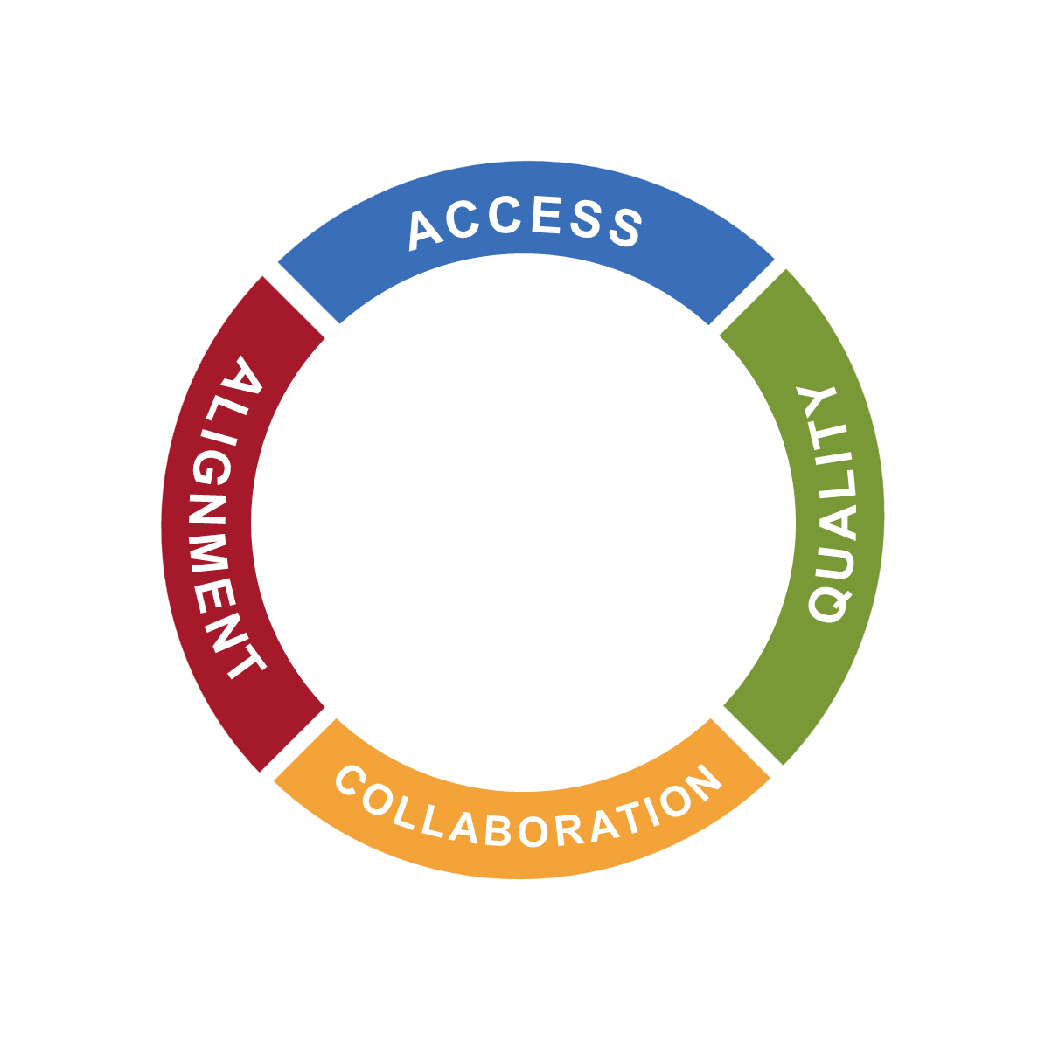
The four goals are grounded in seven values.
Equity
Whole Child
Continuous Improvement
Shared Responsibility
Wise Stewardship
Community Leadership
Continuity of Care
Notes:
The objectives and strategies under each of the four goals are the actions that were recommend by early childhood collaborators to make change. These goals are grounded in the seven values we just reviewed.

Slide 50
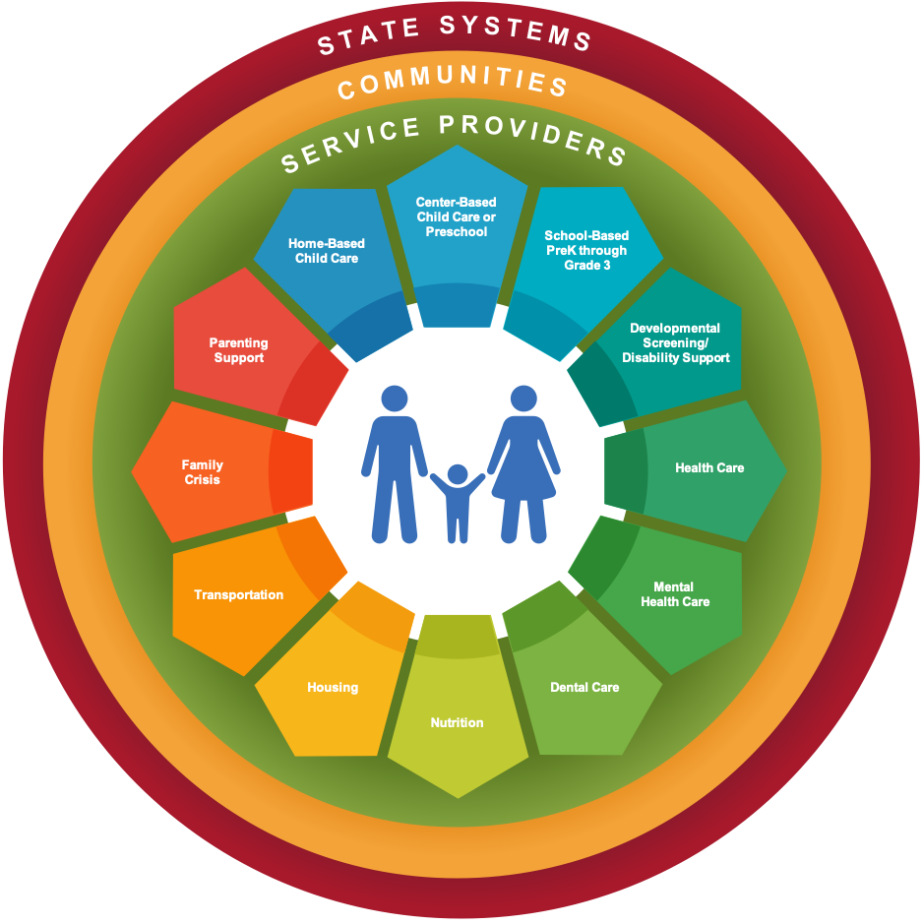
Vision All Nebraska children and their families have access to quality early childhood services that support children’s healthy development from birth through age 8.
Equity
Whole Child
ACCESS
Continuous Improvement
Shared Responsibility
ALIGNMENT
QUALITY
COLLABORATION
Wise Stewardship
Community Leadership
Continuity of Care
Notes:
And the actions defined in each of the goals are designed to impact the state systems, communities, early childhood service providers of all types to benefit of families and children and achieve the Nebraska Early Childhood Strategic Plan vision.
All Nebraska children and their families have access to quality early childhood services that support children’s healthy development from birth through age 8.

Slide 51
What’s next? SPEAQ Up! Nebraska Strategic Planning for Equitable Access to Quality Early Childhood Services in Nebraska SPEAQ Up! Nebraska is a series of community-based conversations designed to ensure the Nebraska Early Childhood Strategic Plan adequately addresses the priorities of diverse communities and stakeholders across the state.
Notes:
Efforts to further develop and refine the Nebraska Early Childhood Strategic Plan are ongoing. In 2022, Nebraskans are invited to participate in conversations about the early childhood priorities, resources, strengths, and challenges specific to their communities.
We are calling these meetings SPEAQ Up! Nebraska – which stands for Strategic Planning for Equitable Access to Quality. This plan is by and for all Nebraskans, so we want Nebraskans to SPEAQ Up! to tell us what the plan should include.
Each SPEAQ Up! Nebraska session is hosted by a member of the local community who will facilitate conversations about the following topics.
What will help families in our community access the early childhood services that will build their wellbeing?
What will help families in our community find quality early care and education?
What opportunities exist for collaboration at local and regional levels to improve access to quality early childhood services?
What changes are needed in statewide early childhood systems, policies, and programs to support improved access to quality care in our community?
Feedback from these conversations will inform further development and implementation of the Nebraska Early Childhood Strategic Plan.

Slide 52
Learn more and get involved. To learn more about the strategic plan, visit NEearlychildhoodplan.org. To host or participate in a SPEAQ Up! Nebraska meeting, please contact Sara Vetter at svetter@nebraska.edu.
Notes:
The strategic plan’s website has all the information you will need to learn more about the plan and get involved.
Visit NEearlychildhoodplan.org.
If you are interested in participating or hosting a meeting, you can also contact contact Sara Vetter at the Buffett Early Childhood Institute.

Slide 53
THANK YOU!
Notes:
Thank you for getting involved in the efforts to improve equitable access to quality early childhood care and education for every child in the state of Nebraska. We look forward to your ongoing partnership.

Slide 54
Acknowledgments
Facilitation of the Nebraska Early Childhood Strategic Plan is provided by the Buffett Early Childhood Institute at the University of Nebraska as part of a broad collaborative effort of the Nebraska Department of Health and Human Services, the Nebraska Department of Education, the Nebraska Children and Families Foundation, and other organizations.
This project is made possible by funding received through Grant Number 90TP0079-03-00, of the USDHHS-Administration for Children and Families, Office of Early Childhood; Nebraska Department of Health and Human Services; Nebraska Department of Education; and Nebraska Children and Families Foundation, following grant requirements of 70% federal funding with 30% match from state and private resources. Its contents are solely the responsibility of the authors and do not necessarily represent the official views of the Office of Child Care, the Administration for Children and Families, or the U.S. Department of Health and Human Services.

Slide 55
www.NEearlychildhoodplan.org

